Slide 1
DANA-4830 Term Project
An Analysis of Airline Passenger Satisfaction Dataset
Group 2 Florence Cheng Phuong-Mai Tran
Andrew Liu Gene Xia
Link to R Code: https://colab.research.google.com/drive/1m0RxIADemABp7sZjUjmYTviI7kGeclcL?usp=sharing

Slide 2
Agenda
Data Collection + Literature Review
PCA + FA
LDA + Stepwise Regression
CA + Further Statistical Analysis
Conclusion
Q&A

Slide 3
DATA COLLECTION
Data Source
Data Description
Possible Biases

Slide 4

Data Source
Source:
Kaggle.com
Link:
https://www.kaggle.com/datasets/teejmahal20/airline-passenger-satisfaction

Slide 5
Data Description
25976 Observations
24 Variables
No duplicated rows
No Outlier Values
83 Missing Values in Arrival.Delay.in.Minutes (0.32% Missing)

Slide 6
Passengers Information Variables
satisfaction (target): satisfied, neutral or dissatisfied
id: Unique ID of each passenger
Gender: Male, Female
Customer.Type: Loyal Customer, disloyal Customer
Age: The age of passengers
Type.of.Travel: Personal Travel, Business Travel
Class: Business, Eco, Eco Plus

Slide 7
Flight Information Variables
Flight.Distance: The distance of a journey
Departure.Delay.in.Minutes: Minutes delayed when depart
Arrival.Delay.in.Minutes: Minutes delayed when arrive
Notes:
Departure.Delay.in.Minutes and Arrival.Delay.in.Minutes have entries of 0 in them. These entries do not represent missing values, but rather that flights did not experience any delays in arrival or departure.

Slide 8
Service Rating Variables
Inflight.wifi.service: Satisfaction level with inflight wifi service (0 : Not Applicable, 1 - 5)
Departure.Arrival.time.convenient: Satisfaction level with departure/arrival time convenient (0 : Not Applicable, 1 - 5)
Ease.of.Online.booking: Satisfaction level with online booking (0 : Not Applicable, 1 - 5)
Gate.location: Satisfaction level with gate location (1 - 5)
Food.and.drink: Satisfaction level with food and drink (0 : Not Applicable, 1 - 5)
Online.boarding: Satisfaction level with online boarding (0 : Not Applicable, 1 - 5)
Seat.comfort: Satisfaction level with seat comfort (1 - 5)
Inflight.entertainment: Satisfaction level with inflight entertainment (0 : Not Applicable, 1 - 5)
On.board.service: Satisfaction level with on-board service (0 : Not Applicable, 1 - 5)
Leg.room.service: Satisfaction level with leg room service (0 : Not Applicable, 1 - 5)
Baggage.handling: Satisfaction level with baggage handling (1 - 5)
Checkin.service: Satisfaction level with check-in service (1 - 5)
Inflight.service: Satisfaction level with inflight service (0 : Not Applicable, 1 - 5)
Cleanliness: Satisfaction level with cleanliness (0 : Not Applicable, 1 - 5)

Slide 9
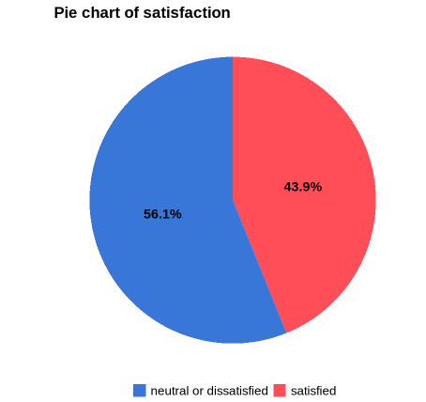
Response Variable - satisfaction
Balance data
Notes:
Balance between 2 categories of response

Slide 10
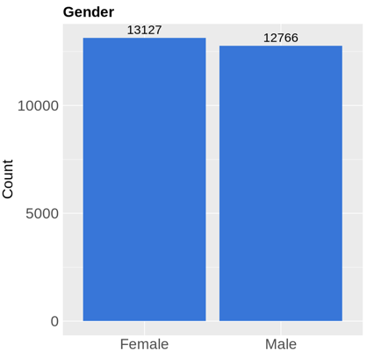
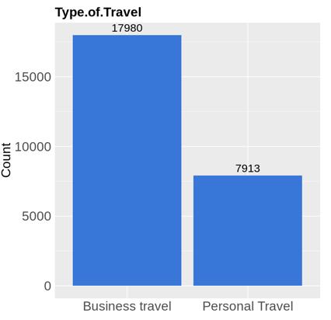
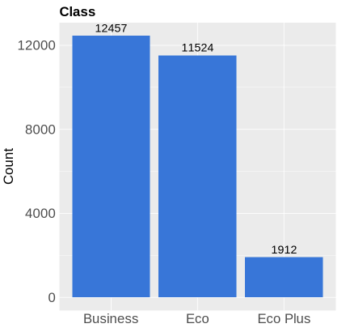
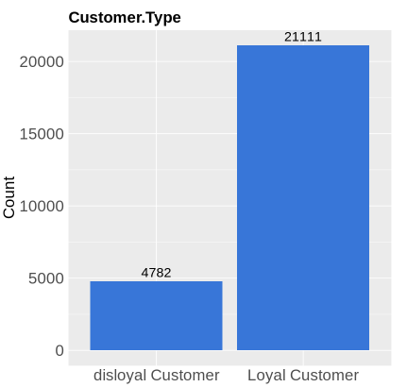
Categorical Variables
Notes:
Profile of passengers surveyed: equal proportion of male/female, relatively the same proportion of business class and eco/eco plus class
But more passengers travel for business than personal, significantly disproportion towards loyal customer

Slide 11
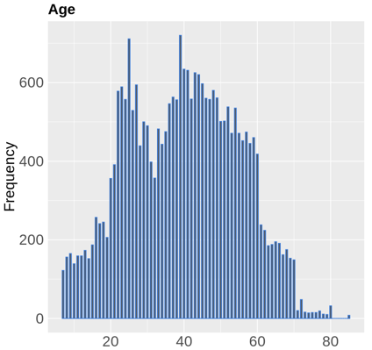
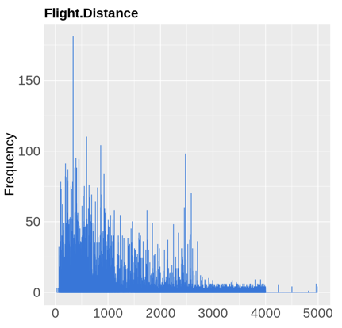
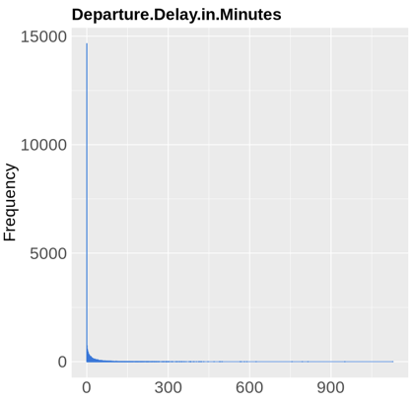
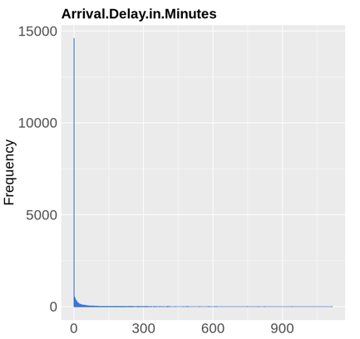
Numerical Variables
Notes:
Age : approximately normally distributed, no extremely outliers
Flight.Distance : most flights are under 1000 miles, skewed left
Dparture/Arrival: most frequent value is 0, meaning no delay

Slide 12
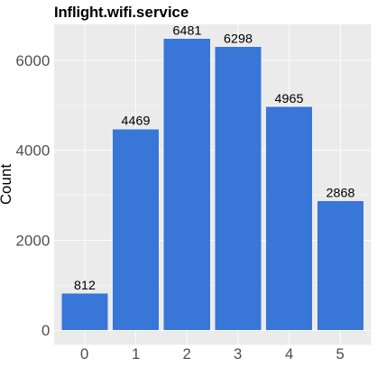
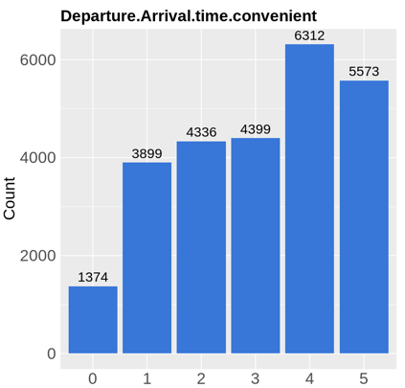
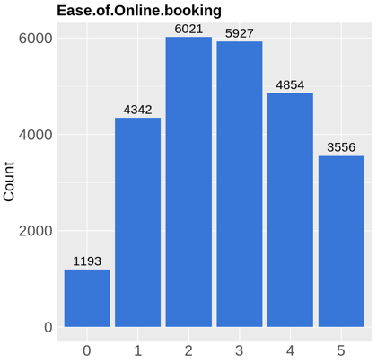
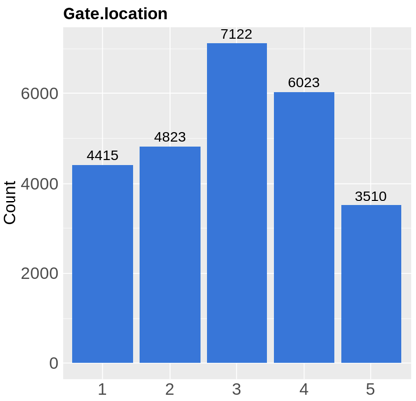
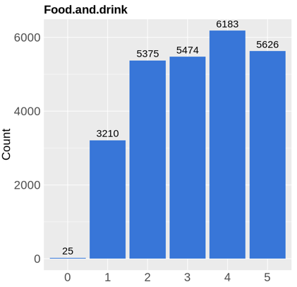
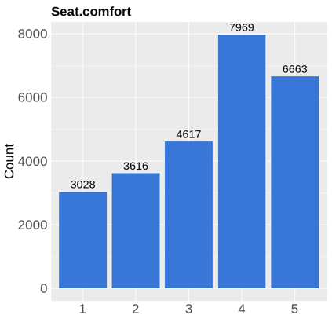
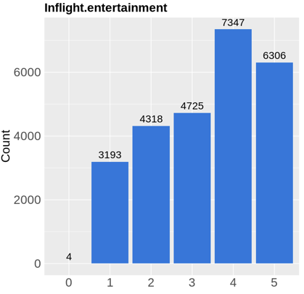
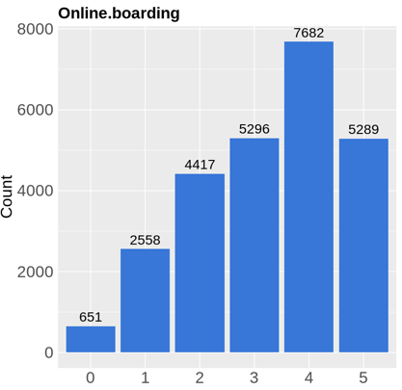
Rating Variables
Notes:
In features with 0 rating, 0 always has the lowest frequency because it’s not actually rating not denote that the service was not offered on the flight

Slide 13
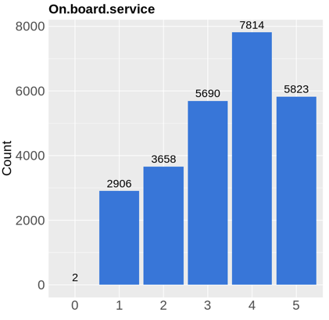
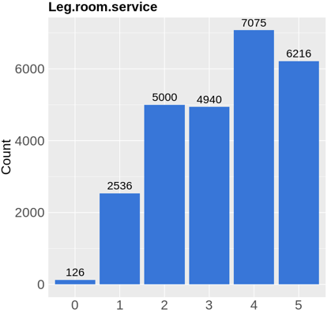
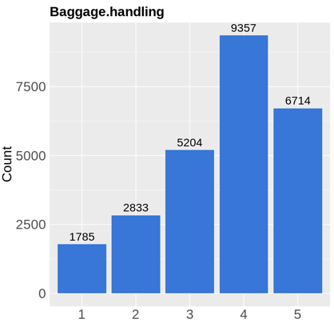
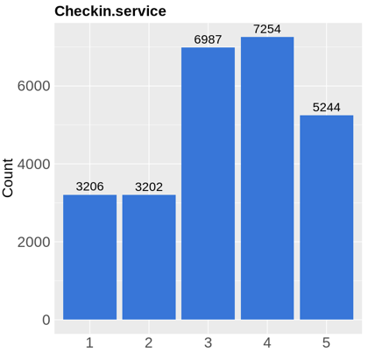
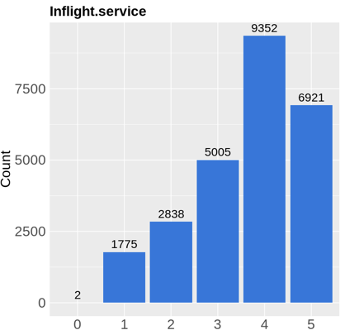
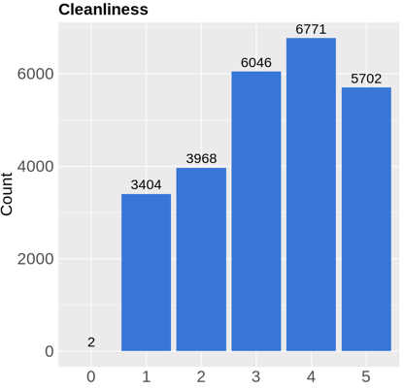
Rating Variables
Notes:
Proportion of different ratings are roughly similar in each features, with rating 4 usually is the most or one of the most occurences

Slide 14
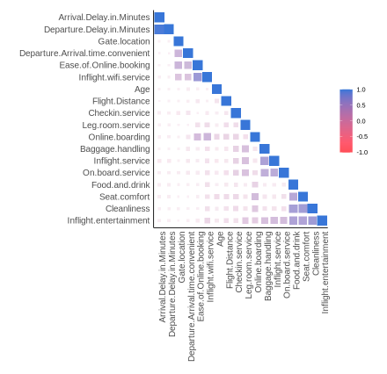
Correlation
Age, Flight.Distance and Checkin.service are highly independent from other variables
(no coefficient > 0.3)
→ excluded from analysis

Slide 15
Possible Biases
Selection bias: clean dataset with no outliers, no information on how data was cleaned or altered.
Response bias: passengers might not have been truthful, or factors such as personal preferences, prior experiences, backgrounds, etc. may lead to variation in their ratings.
Measurement bias: each passenger might have different interpretation or definition of the features/service they are being asked to rate, no information on how the questions were designed.
Recall bias: no information on when survey was conducted in relation to passengers’ most recent flight with the airline, so they may have trouble remembering their experiences accurately.

Slide 16
Project Objectives
1. Use principal component analysis and factor analysis to investigate the underlying patterns of the dataset and identify the factors that are highly correlated to the satisfaction level of US airline passengers.
2. Predict customers’ level of satisfaction with linear discriminant analysis and compare the result with logistic regression models.
3. Visualize new components/factors and compare them across different passengers’ profile (gender, customer type, class)

Slide 17
LITERATURE REVIEW

Slide 18
Research question
Identify the socio-economic characteristics that are significantly correlated with social vulnerability to flooding across 17 Metro Manila cities/municipality.
SEE, J. C. G., & PORIO, E. E. (2015). Assessing Social Vulnerability to Flooding in Metro Manila Using Principal Component Analysis. Philippine Sociological Review, 63, 53–80. http://www.jstor.org/stable/24717187

Slide 19
The study used principal component analysis (PCA) to reduce and group similar variables into component groups. PCA was conducted at 3 levels of analysis: City Level, Barangay Level (smallest administrative division in Philippine) and Household Level. Each component loading was assigned a cardinal direction: (+) if the majority of the variables in the component increase vulnerability, (-) if they decrease vulnerability, and absolute value if they have mixed impact.
The study also constructed a Social Vulnerability Index using the principal components to rank the cities according to their level of vulnerability.
SEE, J. C. G., & PORIO, E. E. (2015). Assessing Social Vulnerability to Flooding in Metro Manila Using Principal Component Analysis. Philippine Sociological Review, 63, 53–80. http://www.jstor.org/stable/24717187

Slide 20
PCA resulted in 5 components at the City Level, 4 components at the Barangay level and 5 components at the Household Level. Analysis highlighted the multidimensionality of the social vulnerability to flooding. Thus, one indicator alone cannot be used to measure the level of vulnerability, but a combination of indicators is needed. While the statistically significant indicators at the City Level and the Barangay Level were similar, two new components appeared at the Household Level, indicating that different aspects of social vulnerability manifest at different levels of analysis.
SEE, J. C. G., & PORIO, E. E. (2015). Assessing Social Vulnerability to Flooding in Metro Manila Using Principal Component Analysis. Philippine Sociological Review, 63, 53–80. http://www.jstor.org/stable/24717187

Slide 21
ANALYSIS
Principal Component Analysis
Factor Analysis
Linear Discriminant Analysis
Stepwise Regression
Correspondence Analysis
Further Statistical Analysis

Slide 22
Principal Component Analysis
Analyze which factor(s) make significant contributions to the model
Identify patterns and relationships among the variables, and reduce the dimensionality of the data to a smaller set of meaningful principal components.

Slide 23
15 variables used in dataset
Inflight.wifi.service
Departure.Arrival.time.convenient
Ease.of.Online.booking
Gate.location
Food.and.drink
Online.boarding
Seat.comfort
Inflight.entertainment
On.board.service
Leg.room.service
Baggage.handling
Inflight.service
Cleanliness
Departure.Delay.in.Minutes
Arrival.Delay.in.Minutes
Excluded (correlation < 0.3)
Age
Flight.Distance
Checkin.service

Slide 24
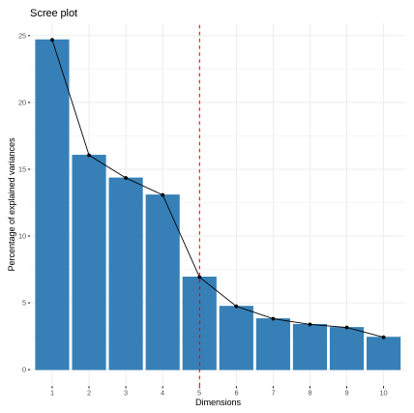
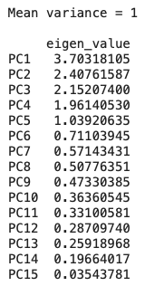
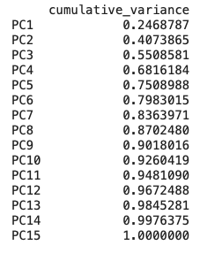
Optimal Number of Components
3 approaches to determine optimal number of PCA:
ScreePlots
Total Variation
Kaiser Criterion
Scree plot
Total variance
Kaiser criterion

Slide 25
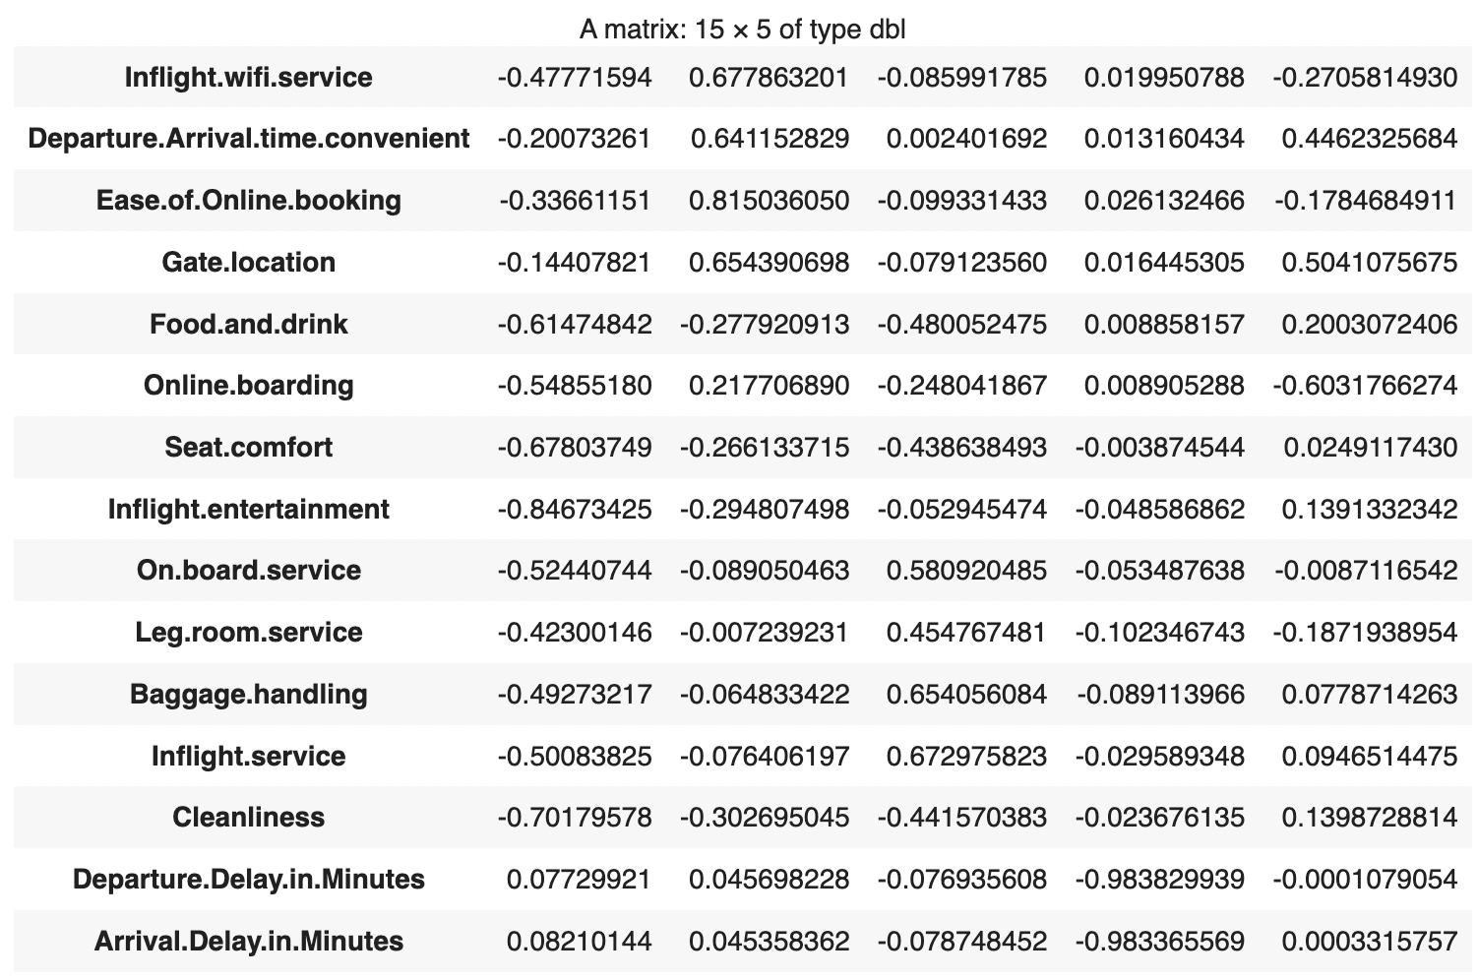
Loadings
Highly-correlated groups:
PC1: Inflight.entertainment, Cleanliness and Seat.comfort
PC2: Gate.location, Ease.of.Online.booking, Inflight.wifi.service and Departure.Arrival.time.convenient
PC4: Departure.Delay.in.Minutes, Arrival.Delay.in.Minutes

Slide 26
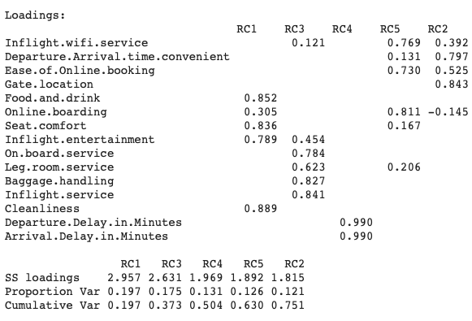
Varimax Rotation
Consider loading = 0.6 as cutoff point
Group 1: In-flight experience
Inflight.entertainment, Cleanliness, Seat.comfort and Food.and.drink
Group 2: Convenience
Gate.location and Departure.Arrival.time.convenient
Group 3: Service
Baggage.handling, Inflight.service and On.board.service, Leg.room.service
Group 4: Punctuation
Departure.Delay.in.Minutes and Arrival.Delay.in.Minutes
Group 5: Technology
Ease.of.Online.booking, Inflight.wifi.service and Online.boarding

Slide 27
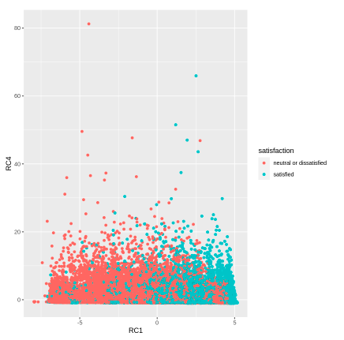
Visualization
2-dimensional plot of PC1 and PC4 with varimax rotation
PC1 and PC4 cannot be categorized according to satisfaction levels
PC1 and PC4 capture only 33% of total variance
Also visualize PCs against other categorical variables to explore how passengers’ profile influence their answers
Notes:
PC1 and PC4 (rotated) captured the most variance

Slide 28
Factor Analysis
Bartlett
χ² = 215937.24
p-value ≈ 0
KMO
Overall MSA = 0.74
p-value < 0.05
→ reject null hypothesis
→ factor analysis may be useful with this dataset
MSA > 0.5
→ there are significant number of factors in this dataset

Slide 29
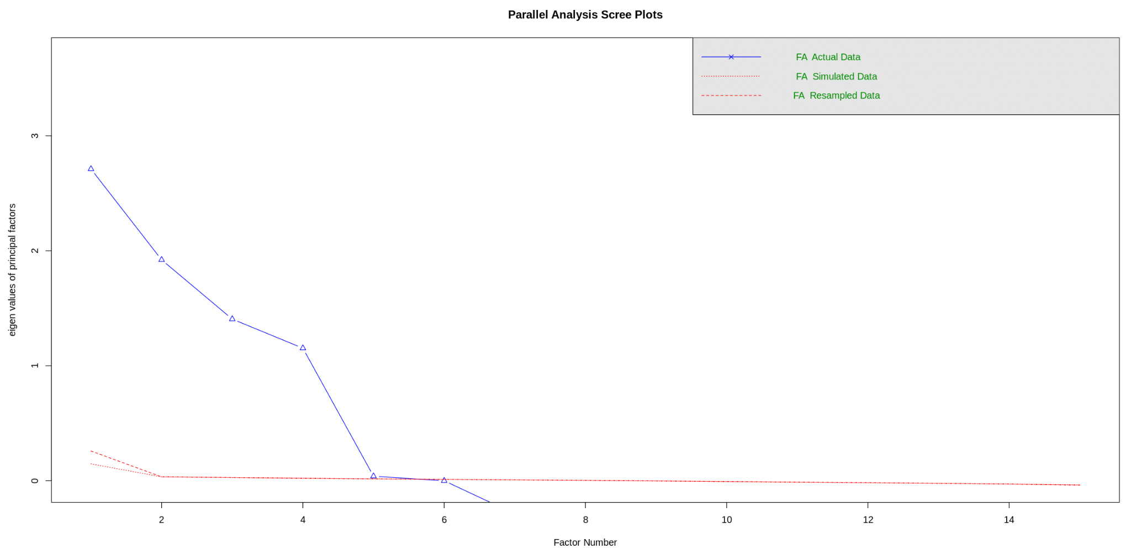
Factor Analysis
Optimal Number of Factors
Methods:
Parallel analysis
Kaiser criterion
ScreePlots
→ 5 factors

Slide 30
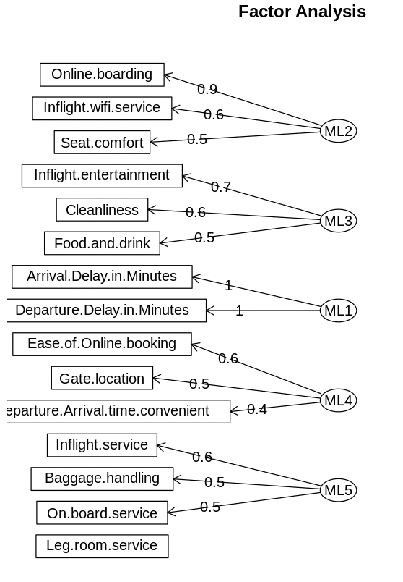
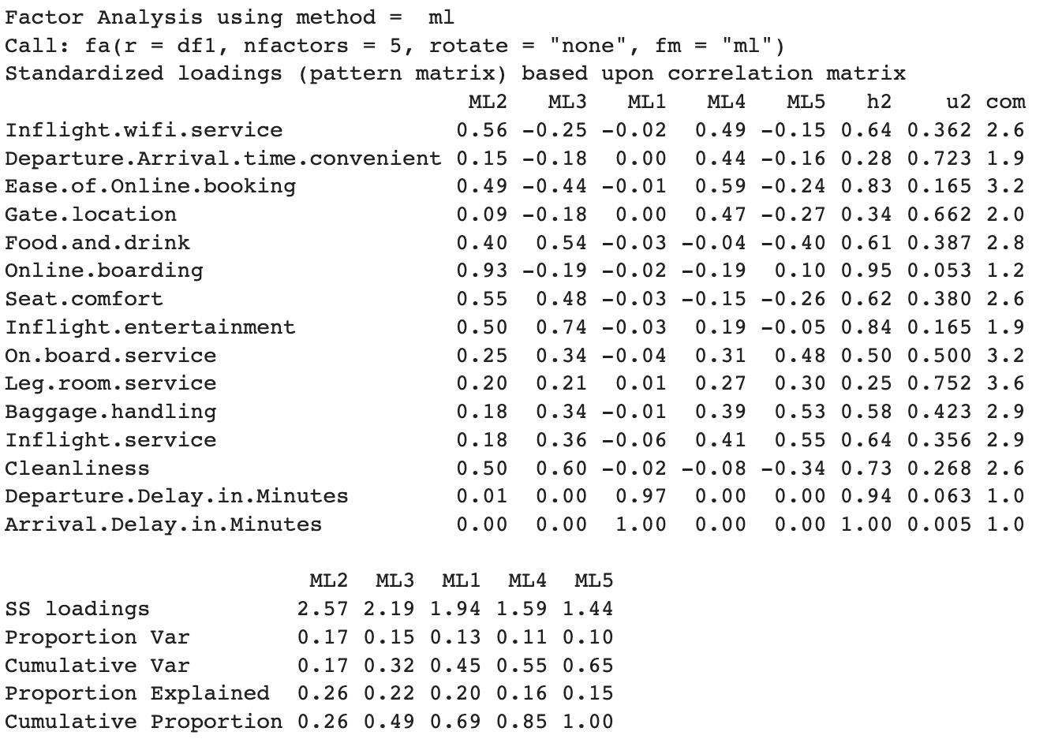
Factor Analysis
Without Rotation

Slide 31
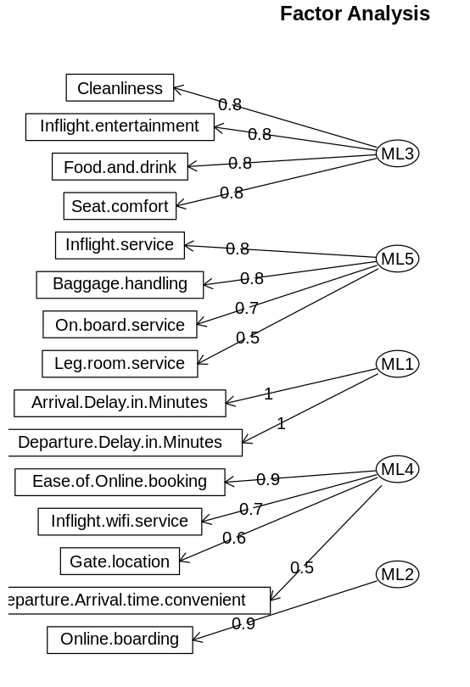
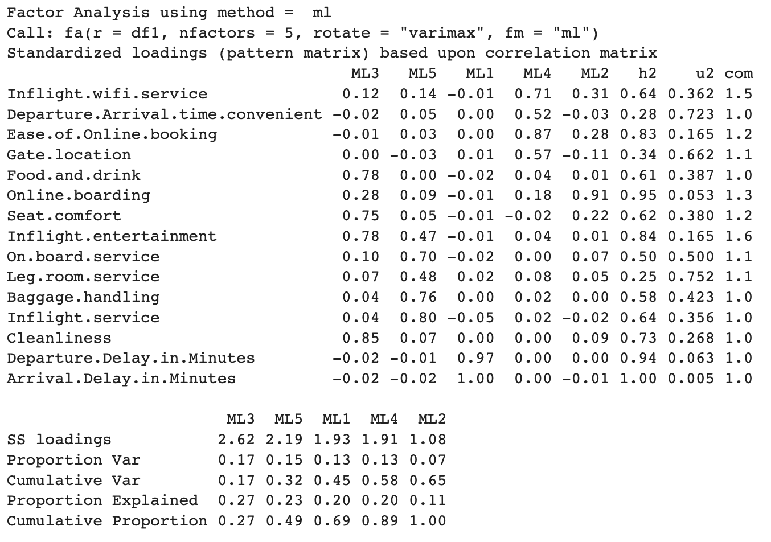
Factor Analysis
With Varimax Rotation

Slide 32
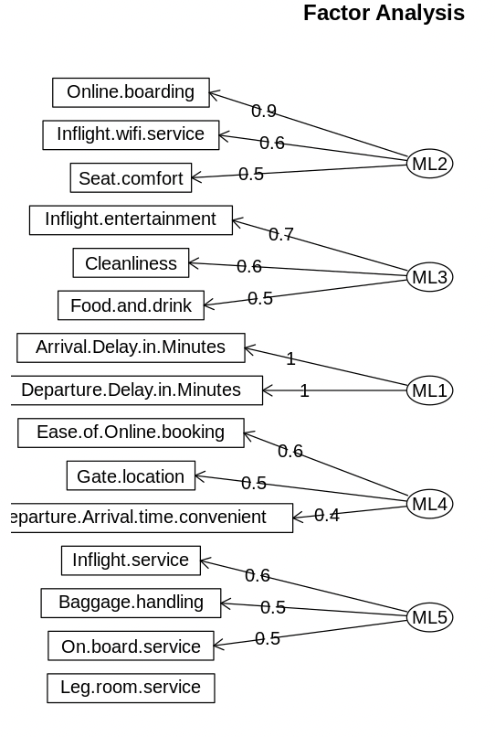
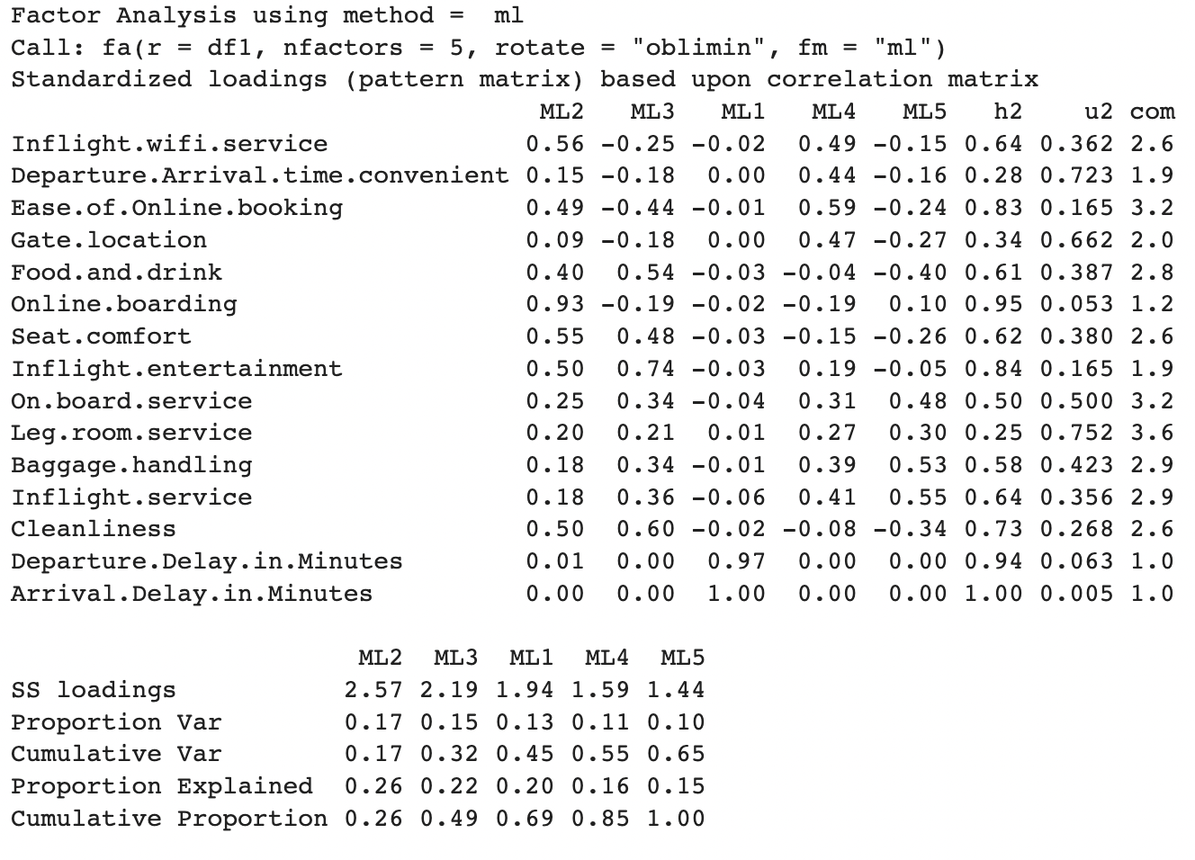
Factor Analysis
With Oblique Rotation

Slide 33
Factor Analysis
Reliability of Factor Analysis
Group | Cronbach’s alpha coefficient
In-flight experience | 0.879
Convenience | 0.772
Service | 0.777
Punctuation | 0.982
Others | not applicable
Cronbach’s alpha coefficient:
Measures internal consistency of a group
Value ranging 0 - 1
Higher value = greater consistency

Slide 34
Comparison of grouping in PCA and FA
PCA | FA
Group 1: In-flight experience Inflight.entertainment, Cleanliness, Seat.comfort and Food.and.drink | Group 1: In-flight experience Inflight.entertainment, Cleanliness, Seat.comfort and Food.and.drink
Group 2: Convenience Gate.location and Departure.Arrival.time.convenient | Group 2: Convenience Ease.of.Online.booking, Inflight.wifi.service, Gate.location and Departure.Arrival.time.convenient
Group 3: Service Baggage.handling, Inflight.service, On.board.service and Leg.room.service | Group 3: Service Baggage.handling, Inflight.service, On.board.service and Leg.room.service
Group 4: Punctuation Departure.Delay.in.Minutes and Arrival.Delay.in.Minutes | Group 4: Punctuation Departure.Delay.in.Minutes and Arrival.Delay.in.Minutes
Group 5: Technology Ease.of.Online.booking, Inflight.wifi.service and Online.boarding | Group 5: Others Online.boarding

Slide 35
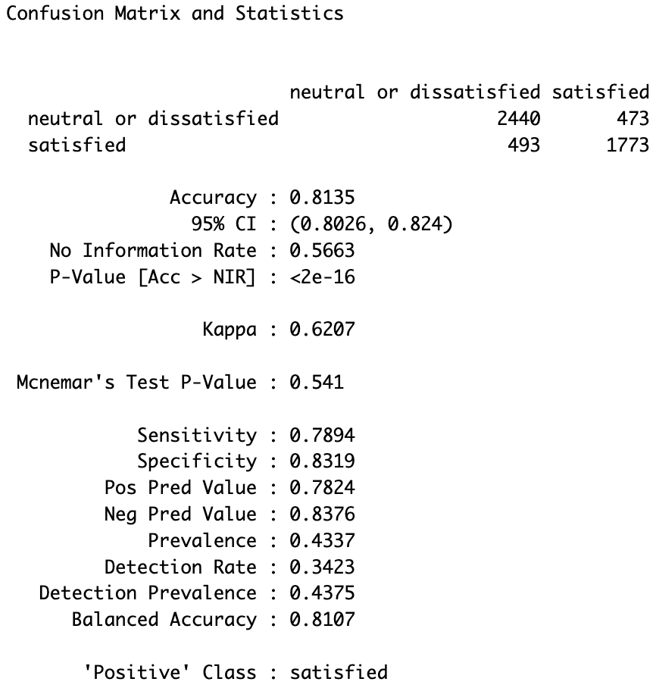
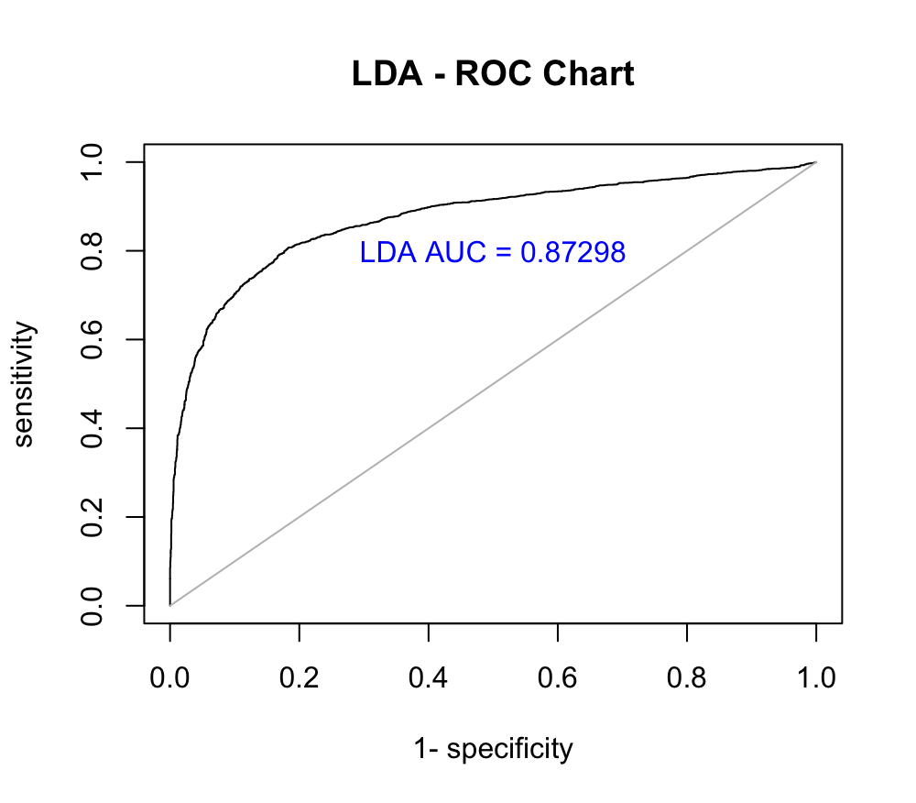
Linear Discriminant Analysis
Use the selected 15 variables
Split dataset into train (80%) and test (20%) data
Conduct LDA classification on train data
Predict using test data
Notes:
The AUC value of 0.87(>0.8) shows the LDA preforms good on prediction in our case.

Slide 36
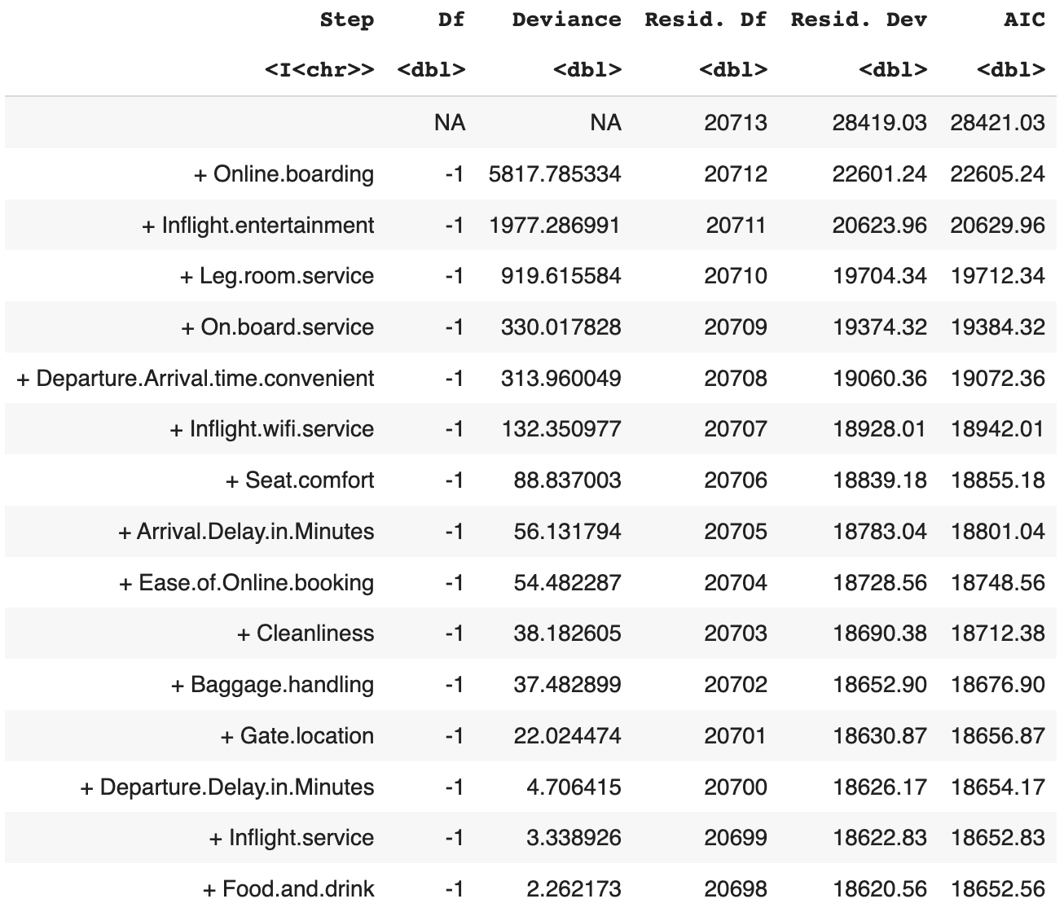
Stepwise Regression
After running Stepwise Logistic Regression on train data, the following variables can be dropped:
Gate.location
Departure.Delay.in.Minutes
Inflight.service
Food.and.drink
Because keeping them do not reduce the AIC too much.

Slide 37
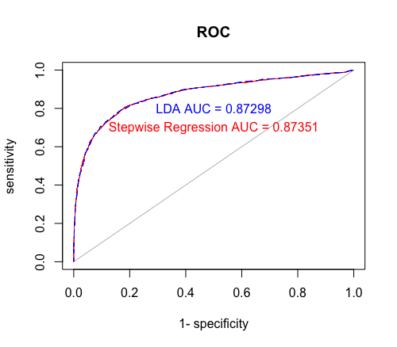
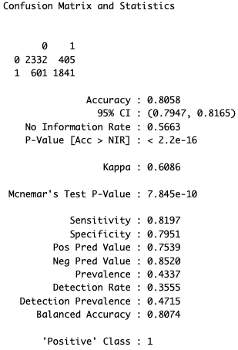
Stepwise Regression
Prediction using test data
The AUC values are similar
(about 0.87 > 0.8) :
Both LDA and Stepwise Regression preformed good on distinguishing customers in terms of their satisfaction levels.
Notes:
As we can see from the plot, The AUC value from LDA and Stepwise Regression model are similar (about 0.87) which indicates that both methods perform similarly well in terms of their ability to distinguish between the customers feeling satisfied and neutral or dissatisfied.

Slide 38
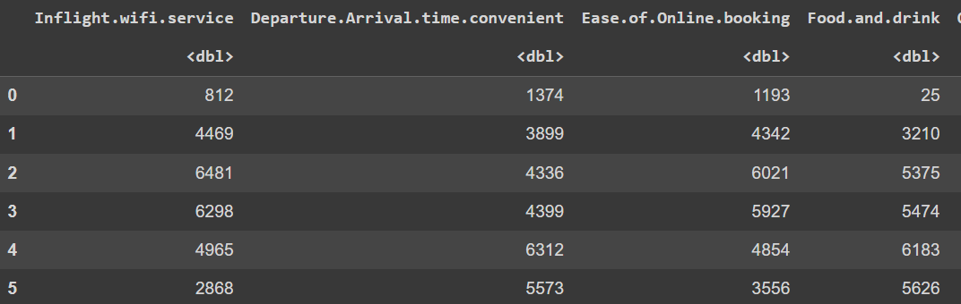
Correspondence Analysis
Contingency Table

Slide 39
Correspondence Analysis
Variables:
Inflight.wifi.service
Departure.Arrival.time.convenient
Ease.of.Online.booking
Food.and.Drink
Online.boarding
Inflight.entertainment
On.board.service
Leg.room.service
Inflight.service
Cleanliness
Chi-Square Test
The chi square of independence between the two variables is equal to 16297 (p-value ≈ 0 )

Slide 40
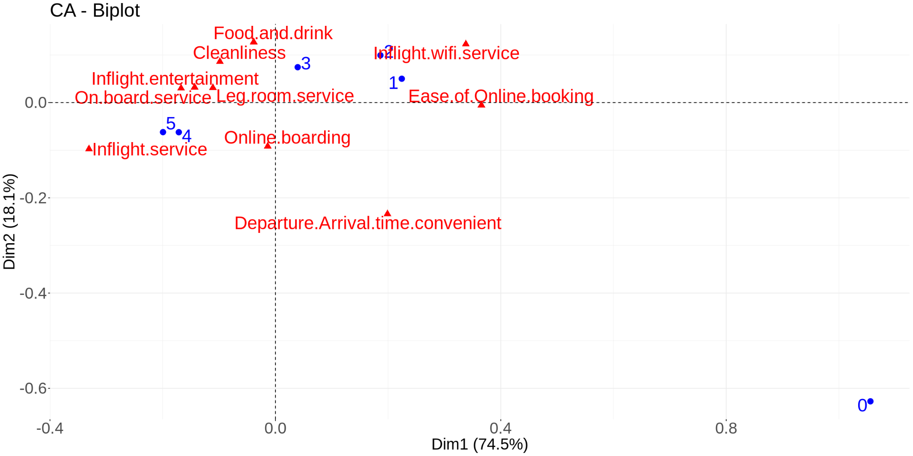
Correspondence Analysis
Notes:
Dimension 1 (74.48%) and dimension 2 (18.23%) add up to nearly 93%. This means the two dimensions capture most of the information in the dataset.

Slide 41
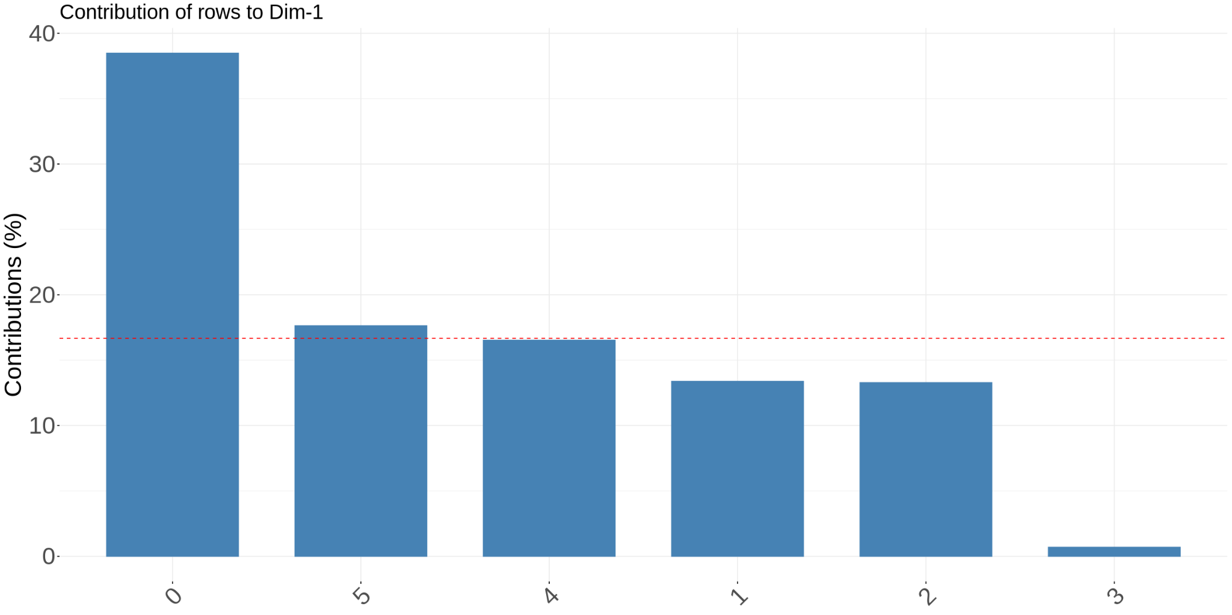
Correspondence Analysis
Dimension 1

Slide 42
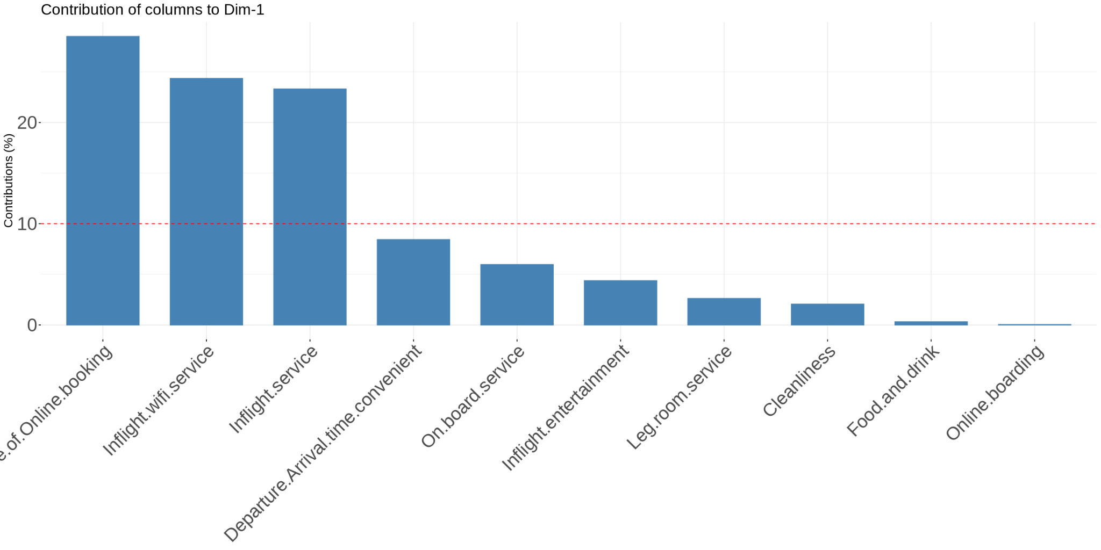
Correspondence Analysis
Dimension 1

Slide 43
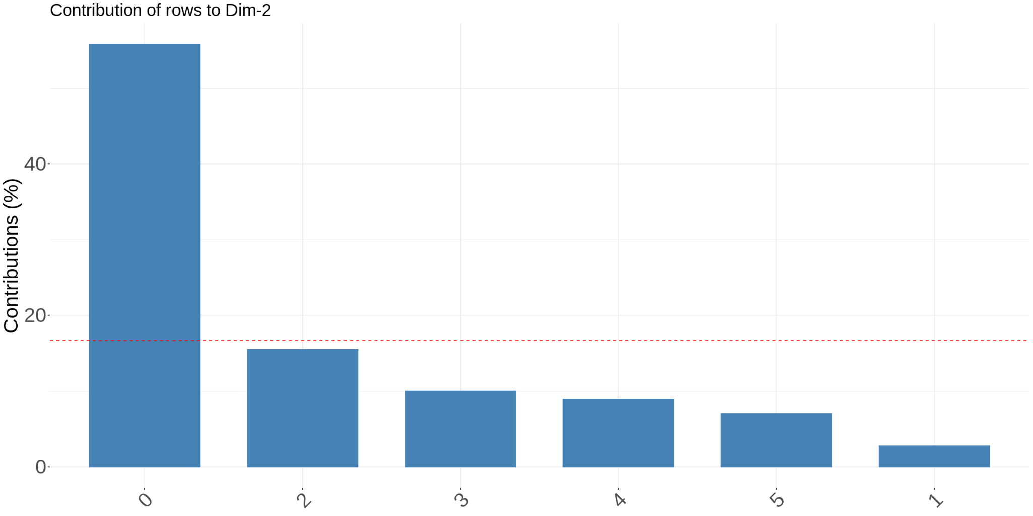
Correspondence Analysis
Dimension 2

Slide 44
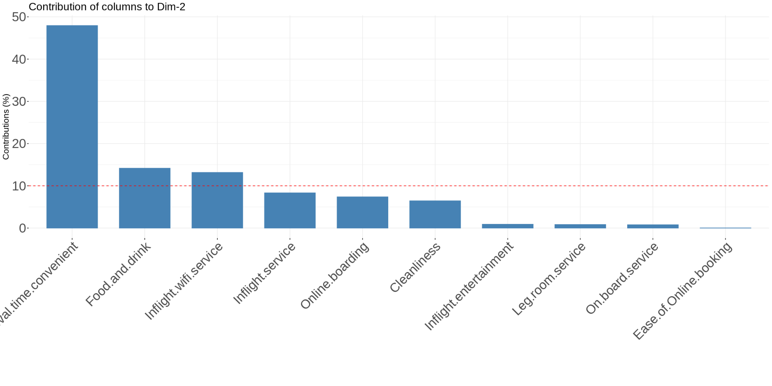
Correspondence Analysis
Dimension 2

Slide 45
Correspondence Analysis
Notes:
Dimension 1 (74.48%) and dimension 2 (18.23%) add up to nearly 93%. This means the two dimensions capture most of the information in the dataset.

Slide 46
Further Statistical Analysis
Comparison of Models’ Prediction
Model | Accuracy | 95% CI | Sensitivity | Specificity
LDA | 81.0% | 80.6 - 81.5% | 78.2% | 83.3%
Logistic regression (all numerical variables) | 80.4% | 79.3 - 81.5% | 81.8% | 79.3%
Logistic regression (all PCs) | 80.4% | 79.3 - 81.5% | 81.8% | 79.3%
Logistic regression (all numerical and categorical variables) | 86.8% | 85.8 - 87.7% | 84.6% | 88.5%

Slide 47
CONCLUSION

Slide 48
PCA and FA categorize interval features into 5 groups: In-flight experience, Convenience, Service, Punctuation and either Technology (PCA) or Others (FA).
Cronbach’s alpha coefficients confirm the internal consistency within the groups categorized by FA, with the exception of the group Others.
LDA provides a relatively good model for prediction, with 81.35% accuracy and an AUC value of 0.87.
The performance of the LDA model and 3 different logistic regression models are comparable to each other.
Stepwise regression model performs as well as LDA model in terms of accuracy.
In CA, 92.71% of the total variance is captured by the first 2 dimensions.
Further Steps: Which factors have the highest influence on the customer satisfaction rate?

Slide 49
Q&A

